Slide 1
Machine Learning Analysis on Black Friday Sales
Christopher Ospina, Suvin Shah, Sai Teja Reddy

Slide 2
Introduction:
Have you ever wondered what goes on between Thanksgiving and Christmas/Hanukkah in the United States?
The average consumer shopping spree happens to make sure everyone gets a gift and it all begins the day after Thanksgiving.
Analyzing data is important to not only learn this year’s outcome but what would happen next year. Every year there is always some trending item on the top of someone’s wishlist

Slide 3
About Black Friday:
After Thanksgiving, stores observe Black Friday as way of generating profit as well as preparing their customers for the upcoming holiday: Christmas where people exchange gifts. Usually this requires spending money to obtain the trending gifts of the year.

Slide 4
Problem Statement
In this Python Notebook we are using pandas, numpy, matplot, seaborn and scikit-learn to analyze black friday data and predict future outcomes. We conducted a data analysis on the eda we found from Kaggle.com to use product categories and purchases as our determining factor.
To model the data we are creating a decision tree as a means of predicting what would happen in the next holiday season.

Slide 5
EXPLORATORY DATA ANALYSIS (EDA)
ALONG WITH THEIR RESPECTIVE VISUALIZATIONS

Slide 6
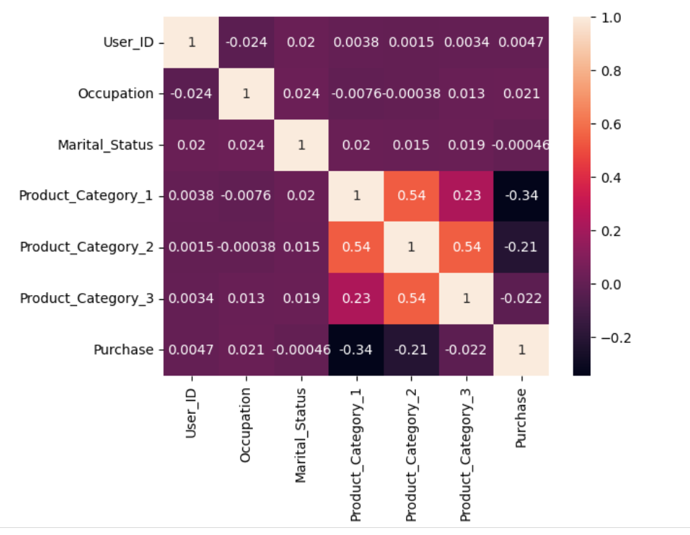
Heat Map

Slide 7
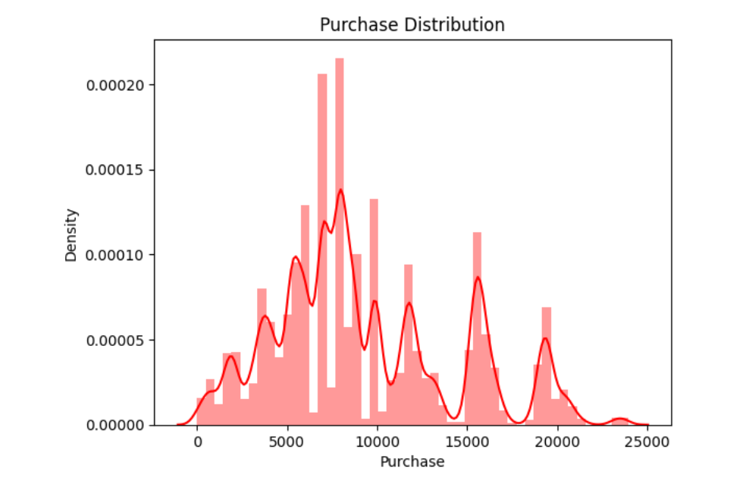
Distplot

Slide 8
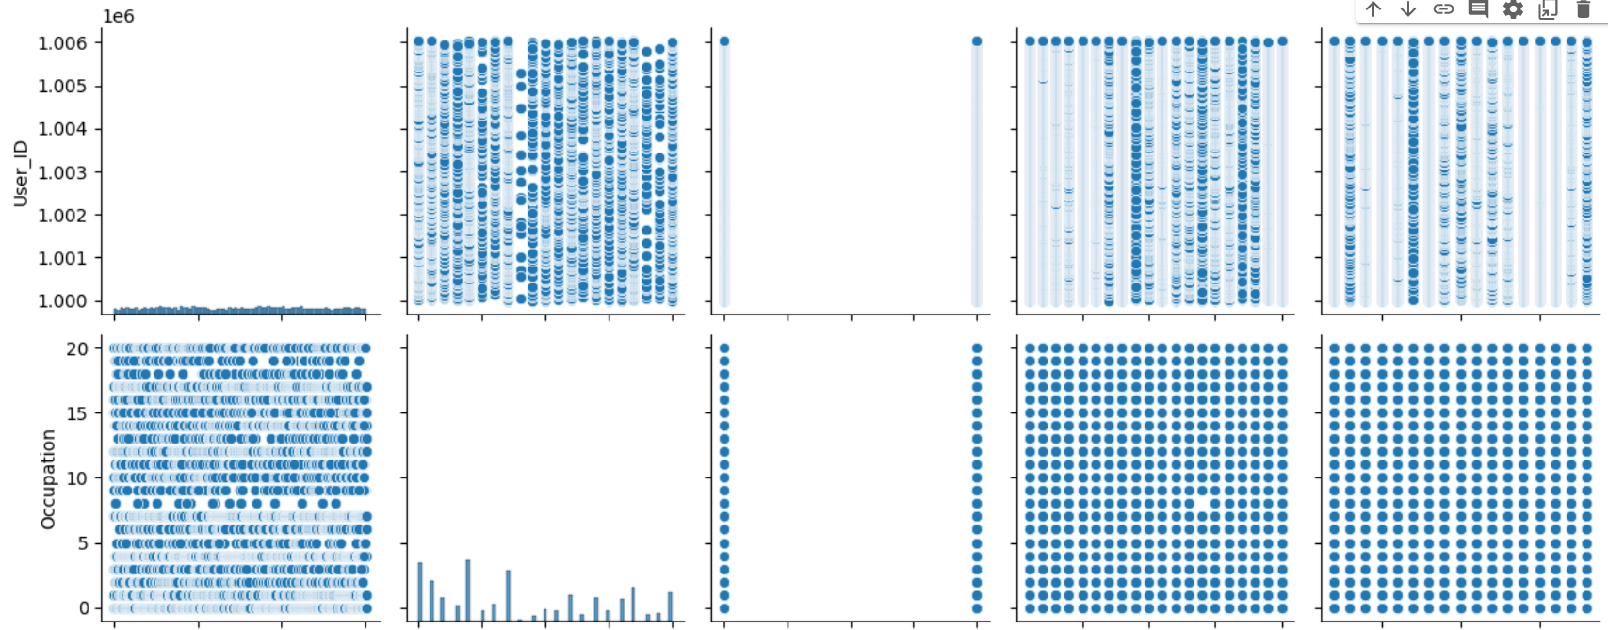
Pairplot

Slide 9
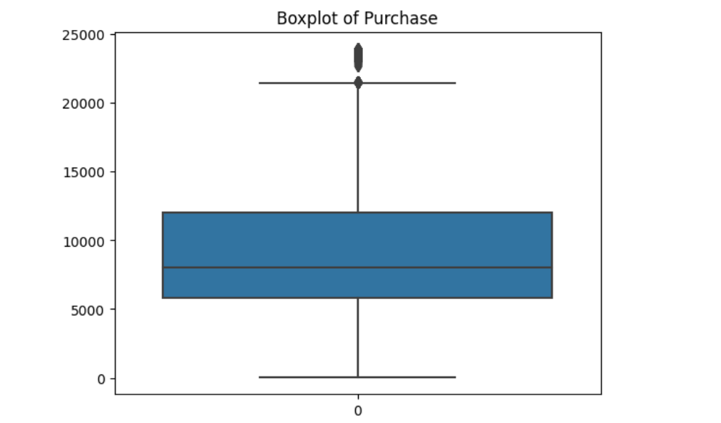
Boxplot

Slide 10
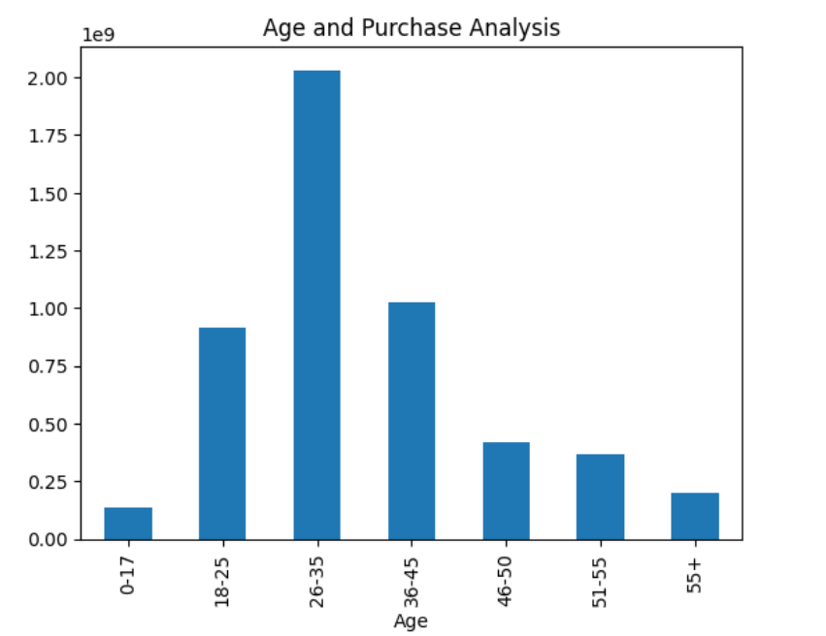
Age and Purchase Analysis

Slide 11
Linear Regression Modeling

Slide 12
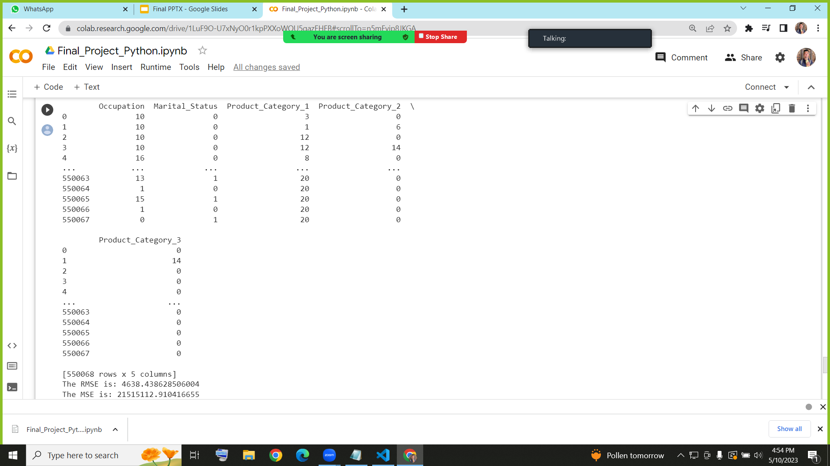

Slide 13
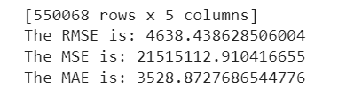

Slide 14
Conclusion
In conclusion, we used the Scikit-Learn Linear Regression model as well as EDA modeling to analyze this past year's Black Friday sales data and predict the RMSE(Root-mean-square deviation), MSE(Mean Squared Error) and the MAE (Mean Absolute Error).
We got results of:
4638.44 for RMSE
21515112.91 for MSE
3528.87 for MAE
From this project we not only learned how to use Python libraries to predict statistical outcomes a given dataset but the importance of coordination and communication when it comes to technical projects like these.

Slide 15
References
Ahmad, Ali. “Black Friday Sales Prediction.” Medium, 21 Dec. 2021, medium.com/@1512aliahmad/black-friday-sales-prediction-cd477ebae018.
This paper presents Analytics Vidhya’s Black Friday dataset and how one data analyst built a data model using Deep Learning concepts to predict outcomes
https://medium.com/@1512aliahmad/black-friday-sales-prediction-cd477ebae018
Contributor, Guest. “Analysis of Black Friday Shopping Trends via Machine Learning.” Stack Abuse, 1 May 2019, stackabuse.com/analysis-of-black-friday-shopping-trends-via-machine-learning/.
This paper presents a tutorial on how to use python to predict black friday sales
https://stackabuse.com/analysis-of-black-friday-shopping-trends-via-machine-learning/
"Predicting Customer Purchase Behavior on Black Friday using Big Data Analytics" by S. Panigrahi and S. K. Mohanty.Link: https://ieeexplore.ieee.org/document/9008335
This paper presents a big data analytics approach to predict the customer purchase behavior on Black Friday. The authors use algorithms such as logistic regression and random forests to analyze the customer browsing and search history, demographic information, and interactions with the website to predict the likelihood of a purchase.

Slide 16
References Part 2
"Black Friday Sales Prediction using Machine Learning Algorithms: A Comparative Study" by S. Prasad, A. Sinha, and R. K. Singh.Link: https://ieeexplore.ieee.org/document/8983055
This paper presents a comparative study of various machine learning algorithms such as linear regression, decision trees, and k-nearest neighbors in predicting the sales of products on Black Friday. The authors also analyze the importance of various features such as category, brand, and price on the sales data.
“Black Friday Sales Prediction Using Supervised Machine Learning.” IEEE, ieeexplore.ieee.org/abstract/document/10084959. Accessed 10 May 2023.
The paper discusses the significance of machine learning in various fields, including business decisions, facial recognition, and natural language processing. It highlights the importance of understanding and predicting the purchase pattern of customers based on their demographic features to develop a predictor model for Black Friday sales. The developed model was tested with various classification techniques, and a Random Forest regression-based approach was used for predicting Black Friday sales.
“Data Analysis and Price Prediction of Black Friday Sales Using Machine ...” Researchgate, www.researchgate.net/publication/354690216_Data_Analysis_and_Price_Prediction_of_Black_Friday_Sales_using_Machine_Learning_Techniques. Accessed 10 May 2023.

